Slide 1
2019 Fall Prep Update

Slide 2
Table of Contents
Enrollment Management (p. 4-30)
- Undergraduate Admissions/Orientation (p. 5-8)
- Office of the Registrar & Student Records (p. 9-14)
- Student Financial Services / Scholarships (p. 15-16)
- Graduate and International Student Services (p. 17-21) - Success Advising Center (p. 22-24)
- Learning Commons (p. 25-30)
Extended Studies (p. 31-35)
- UCM – LS Campus (p. 36-39)
- Study Abroad (p. 40-41)
Office of Technology (p. 42-47)
- Technology Support (p. 42-47)

Slide 3
Table of Contents
Academic Programs and Services (p. 48-60)
- Graduate Education and Research (p. 52-57)
- Career Development Services (p. 58-60)
Student Experience and Engagement (p. 61-93)
- Campus Community Health (p. 63-68)
- Dining (p. 69-71)
- Elliott Student Union (p. 72-75)
- Public Safety (p. 76-79)
- Student Activities (p. 80-81)
- Student Behavior and Referrals (82-87)
- University Store (p. 88-94)
Office of Accessibility Services (p. 95-96)
JCKL Library (p. 97-104)
- CTL – Center for Technology and Learning (p. 105-112)

Slide 4
Enrollment Management

Slide 5
Undergraduate Admissions/Orientation

Slide 6
New Team Members
Sarah Smith – CRM Administrator
Ashley Meisner – Office Professional II
Cameron Conner – STL Regional Admissions Rep
Don Kennedy – Local Admissions Rep
Christin Dalivaras – Event Coordinator

Slide 7
Admissions
Implemented Common Application
UCM was approved to host the MOACAC Johnson County Regional College Fair – set for Thursday, September 26th
Admissions & IMC have partnered to improve communication to prospective students with increased personalized messaging

Slide 8
Top 10 (Based on freshmen admits)
Top 10 High Schools
Top 10 Programs
Lees Summit West High School
Warrensburg High School
Lees Summit Senior High School
Blue Springs High School
Blue Springs South High School
Lees Summit North High School
Pleasant Hill High School
Raymore-Peculiar High School
Smith-Cotton High School
Ruskin High School
Open Option | 489
Nursing | 372
Biology | 266
Criminal Justice | 163
Computer Science | 126
Psychology | 124
Professional Pilot | 122
Elementary Education (1-6) | 111
Secondary Education | 101
Engineering Technology | 87

Slide 9
Office of the Registrar & Student Records

Slide 10
Registrar’s Office Staffing Changes
Allison (Allie) Dean is now the Articulation and Graduation Coordinator (as of December 1, 2018).
Laura Lindquist began April 15th as Academic Records Specialist (replacing Allie’s former position).
Katarina (Katie) Butts began May 6th as Academic Records Specialist (replacing Leslie Cooper’s former position).

Slide 11
Academic Dates and Deadlines
The best place to find a comprehensive list of 2019-2020 academic deadlines: https://catalog.ucmo.edu/content.php?catoid=9&navoid=283
The 2nd best place: https://www.ucmo.edu/calendar/index.php
Spring 2020 Enrollment Dates: https://www.ucmo.edu/current-students/office-of-the-registrar-and-student-records/dates-and-deadlines/index.php
Refund Dates: https://www.ucmo.edu/current-students/office-of-the-registrar-and-student-records/dates-and-deadlines/index.php

Slide 12
FERPA
Everything you wanted to know about FERPA but were afraid to ask can be found online at: https://www.ucmo.edu/current-students/office-of-the-registrar-and-student-records/student-privacy/index.php
Directory information includes, but is not limited to name, address, phone number, email address, major field of study, part time/full time status, etc.
Non-directory information includes, but is not limited to gender, ethnicity, transcript, grades, hours enrolled, degree audit, etc.
Authorization form to release information can be found at https://www.ucmo.edu/current-students/office-of-the-registrar-and-student-records/internal-resources/shared/forms/authorizationtoreleaseeducationalrecords10-3-18.pdf
When in doubt, contact Registrar’s Office

Slide 13
Final Grades
Summer grades due at noon on Tuesday, August 13 for the 12-week session and last 6-week session courses
Fall semester is over Friday, December 6
Fall grades are due at noon Tuesday, December 17
Final grades are ALWAYS due the Tuesday AFTER finals week at 12:00 noon
Please help us by making sure your faculty have grades in on time to help with our processing
Missing grades report available in Argos: Academic Dept. Reports-Grade Information- Missing Grades. Please start running this report before Tuesday!

Slide 14
Additional Resources
Registrar's Homepage: www.ucmo.edu/registrar/
Registrar’s Facebook Page: UCM MoInfo
Registrar’s Twitter Page: @UCMRegistrar
Registrar’s Office Monthly Newsletter: via e-mail on the first day of every month
Registrar’s page for Faculty/Staff: https://www.ucmo.edu/current-students/office-of-the-registrar-and-student-records/internal-resources/fac-staff/index.php
BANNER How-To Information: https://www.ucmo.edu/current-students/office-of-the-registrar-and-student-records/internal-resources/fac-staff/banner-ellucian-instructions/
Catalogs: www.catalog.ucmo.edu

Slide 15
Student Financial Services / Scholarships

Slide 16
Student Financial Services/Scholarships
Awarding for 19/20 began December 2018
Red and Black Scholarship Amounts updated for 19/20 - for further information, please visit website @ https://www.ucmo.edu/future-students/tuition-costs-and-financial-aid/financing your education/scholarships/index.php
20/21 FAFSA can be filed beginning October 1, 2019 using 2018 tax data
UCM Scholarship Finder (Formerly MOCents) will be available for 20/21 beginning August 1, 2019

Slide 17
Graduate and International Student Services
15

Slide 18
Graduate Admissions Update as of 7/15/19
Applications/Admits
Ed. Specialist (65/53)
Graduate Certificate(16/5)
Graduate Degree (754/340)
Non-Degree Seeking (19/11)
Alternative Teaching Cert (24/16)
Doctoral (10/8)
Special Credit (7/3)
Top States (Excluding MO)
Kansas
Illinois
California
Arkansas
Florida
Top Programs (Applications)
EdS in Educational Leadership
MBA
MS in Counseling
MS in College Student Personnel Administration
MAT
MS in Nursing
MS Library Science and Information Systems
16

Slide 19
International Admissions Update as of 7/15/19
Applications/Admits
Exchange (49/39)
Undergraduate(404/106)
Graduate (1457/719)
Top Countries
India Japan
Nigeria Saudi Arabia
Ghana Pakistan
Nepal South Korea
Kenya Iran
Top UG Programs
BS Computer Science
BS Nursing
Undeclared
BS Accountancy
BS Engineering Technology
Top GR Programs
MS Computer Science
MS Computer Information Systems
MS Big Data Analytics & IT
MS Industrial Management
MS Cybersecurity & Information Assurance
17

Slide 20
International Student Orientation
Fall 2019 Orientation will be held August 13th – 16th.
Many students will begin arriving on campus August 11th and 12th.
We are expecting approximately 200+ students.
Prior to arrival, graduate students will complete an online orientation, via MyCentral.
18

Slide 21
International Student Orientation
All student will attend various sessions including:
Campus Tour
Health Center Screening
US Bank/ ID pickup
International Insurance Session
Document Collection/ Verification
Visa Presentation
On campus Employment Session
Campus Community Health Session
Community Engagement Session
Academic Departmental Sessions
19

Slide 22
Success Advising Center

Slide 23
The Success Advising Center
Since the beginning of the 18-19 academic year, the Success Advising Center opened its doors to students, celebrating its grand opening on October 10th. Now nearing the completion of our first academic cycle, and having experienced numerous successes, we are looking forward to an even greater 19-20 academic year. That said, the learning curve was definitely in play. Based on what we learned, here are some changes to highlight:
Caseload Reassignments: To ensure greater stability in advisor-student relationships, and to better balance caseload equity, programs in the School of Nutrition, Kinesiology & Psychological Science have been reassigned
Health Studies majors are now aligned with other allied health majors
Psychological Science majors are now aligned with other human services majors
Nutrition and Kinesiology majors remained in their current alignment
Success Coaching (Advisor to student): To better serve UCM Advantage, and other special populations, we have instituted an opt-in, bi-weekly success coaching element. This will serve to develop a stronger relational connection to their success coach, which will enable more efficient nudging to keep vulnerable students on course. This is in addition to the minimum requirements outlined in their program agreements.

Slide 24
Academic Success Coaching (peer to peer coaching) has been scaled. We now have 24 Academic Success Coaches/Peer Mentors who have been partnered with Academic Success Advisors strategically to work with their caseload. Additionally, each of them will be embedded in a UNIV1400, University Foundations course, and some will be embedded in other student development courses such as UNIV 1410, Exploring Majors and Careers, or UNIV1800 College Reset. All Academic Success Coaches/Peer Mentors are NASPA Nationally Certified Peer Educators.
We will be offering a NASPA CPE course for students who are working one-on-one with other students, or in student leadership positions this Fall.
Faculty Mentors: After working through the initial construct development of the Faculty Mentoring program, students will be assigned to a faculty mentor as prescribed by each academic program. With Banner 9 now in place, each student will now have the names, faces, and contact information of their Success Team. The success teams include: Academic Success Advisor, Academic Success Coach, Financial Aid Counselor, Career Advisor, and Faculty Mentor.
SSC GUIDE: After conducting a cost-benefit analysis, the SSC “Guide” student facing app was discontinued.

Slide 25
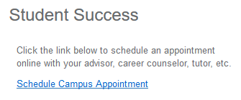
Success Advising Walk-in Hours
If you are engaged in helping students in any capacity, please know that the SAC will have walk-ins from 8:00-5:00 August 19-22 (Add/Drop Period), and 1:00-4:00 Monday-Thursday all semester.
Students can schedule an appointment with their Success Advisor, Success Coach or other members of their Success Team at any time by logging in to their MyCentral, and clicking on the “Schedule Campus Appointment” link in the Student Success box in the upper right hand corner.
They can also schedule an appointment by calling 660-543-4721.

Slide 26
Learning Commons

Slide 27
Learning Commons
The Learning Commons will be open the first day of classes.
Monday-Thursday 9am-7pm, Friday 9am-10pm
Students will be able to schedule appointments for Writing Center, Math, GEA test preparation, and Study Plan tutors through SSC or in person.
More information and schedules at www.ucmo.edu/learningcommons.

Slide 28
Learning Commons-Workshops
Start strong workshops will be offered the first two weeks of class
Help with Blackboard and MyCentral
Help with all things Google
All workshops will have the option to reserve a seat.
Weekly workshops will be available in person and online via Zoom starting 8/26.
Weekly Workshops will focus on
Writing
Managing test anxiety
Study skills
GEA test preparation

Slide 29
Learning Commons-Writing Center
The Writing Center will continue to offer writing support to undergraduate and graduate students at all stages of the writing process. Students may either walk-in or make an appointment
Students may also submit their papers to the Online Writing Lab 24/7 and receive feedback from a tutor within 48 business hours https://www.ucmo.edu/offices/learning-commons/writing-center/

Slide 30
Learning Commons-Supplemental Instruction
Supplemental instruction offers peer-facilitated study groups for students in the following courses:
ENG 1000 Intro to College Writing
MATH 1010 Fundamentals of Algebra
MATH 1020 Fund. of Mathematics
MATH 2410 Discrete Mathematics
MATH 1152 Calculus 2
MATH 1131 Applied Calculus
BIOL 3401 Human Anatomy
BIOL 3402 Human Physiology
BIOL 3611 Microbiology
ANTH 1820 Cultural Anthropology

Slide 31
Learning Commons-Tutoring Center
Provides drop-in tutoring in 100+ UCM courses. A live schedule can be found on the Learning Commons website. Cancellations and changes will be updated to this schedule daily.
One-on-one appointments for Math up to Calculus 1 will be available in-person and online via Zoom.
Students will now be able to meet one-on-one by appointment with a Study Plan tutor to develop an individualized study plan. These sessions can be in-person or online via Zoom.
STEM tutoring in limited classes will be offered in Yeater Hall on Tuesday, Wednesday, and Thursday evenings from 7-9pm.

Slide 32
Extended Studies

Slide 33
CampusCE
Noncredit Registration System
Registration system provides registration payment options for non credit courses.
This registration system is open for all departments. If you would like to offer a workshop, seminar or noncredit certificate program that requires registration and payment options, please contact Extended Studies.
Ucmo.edu/workforce

Slide 34
Extended Studies Contact List
ADMINISTRATIVE AND FISCAL, Humphreys Bldg., Room 410 x4984
Laurel Hogue, Vice Provost for Extended Studies
Susan Delap, Coordinator, Fiscal & Business Operations
Marcia Clemens, Administrative Assistant
ACADEMIC OUTREACH, Humphreys Bldg., Room 410 x4984
Vicki Orcutt, Director, Academic Outreach
Joyce Huffman, Outreach Coordinator
Courtney Irvine, Whiteman AFB Site Coordinator
STUDY ABROAD, Center for Global Education, Union 302 x4195
Matt Chiesi, Study Abroad Coordinator
DUAL CREDIT, Humphreys Bldg., Room 401 x4876
Sandy Cruz, Director, Dual Credit
Paige Walters-Young, Program Assistant
Rick Schmidli, WeMET Coordinator
Haley Farnsworth, Student Services Coordinator
Mike de Laurier, AV Systems Coordinator

Slide 35
MISSOURI INNOVATION CAMPUS, 1101 NW Innovation Parkway, Lee’s Summit MO x8228
Stan Elliott, Director, Missouri Innovation Campus
Rick Smetana, Operations Manager
Joseph Mullins, Workforce Development
Clarinda Dir, Program Manager, Workforce Development 660-543-6622
Brenda Fuhr, Lead Coordinator of Student Transition & Engagement
Katie Honomichl, Coordinator of Student Transition & Engagement
Nathan Flowers, IT Technician
Karen Dexter, MIC Program Innovation Coach
Gentry Scavuzzo, MIC Program Internship Coordinator

Slide 36
Dual Credit
Full-time employees and their dependents qualify for UCM’s educational assistance benefits. Dual credit classes receive a 50% up-front tuition discount. Contact HR for requirements and FAQs.
Most high schools in surrounding counties are UCM partners.
Dual credit classes are available at the high school, on the UCM campus, online, ITV, and in hybrid formats.
Help your dependents graduate with less debt and in less time with dual credit.

Slide 37
UCM-LS Campus

Slide 38
UCM-Lee’s Summit
Operating hours are M-F from 7 am to 9 pm and Saturday from 8 am to 5 pm
The MIC Building is BYOD “Bring Your Own Device”
Faculty, students, and staff need to bring their own laptop, tablet, and or phone to the new building
License UCM software will be provided by a virtual desktop software solution
UCM Bookstore is open from 2 pm to 6 pm from M-Th
Conference Center and Classrooms are available for:
Meetings
Advisory Boards
Conferences
Trainings
Learn more about the facility at: www.ucmo.edu/summit

Slide 39
Student Services and Activities
MIC Learning Commons:
Pickup international documents, library books, and bookstore orders
Laptop checkout for students, faculty, and staff (day use only)
Receive writing and reading assistance
Get tutoring help with coursework
Improve study skills and general test preparation
Work on homework or group projects
MIC Student Activities
Movie nights with popcorn and lemonade
Recreational ping pong
Student appreciation week

Slide 40
Missouri Innovation Campus Building
Map and Parking
The address for MIC is: 1101 Innovation Parkway Lee’s Summit MO 64063
A map with driving directions can be found at https://www.ucmo.edu/summitcenter/services/documents/MIC_map.pdf
Students and guests can park in the south parking lot
Faculty and staff can park in either the west or south parking lot

Slide 41
Study Abroad

Slide 42
Study Abroad at UCM
Study Abroad Coordinator, Matt Chiesi, x8296, chiesi@ucmo.edu
Primary point of contact for Study Abroad Questions
Advising, Applications, Course Substitutions, Faculty-Led (short term) Tours, Fairs / Study Abroad 101, Grants / Scholarships / Financial Aid, Program Fees / Exchange, Terra Dotta
International Study Grants
$1500 grant for semester exchange
$1000 for semester non-exchange
$500 for summer programs
$350 for Faculty Led programs

Slide 43
Office of Technology

Slide 44
If You Have Moved...
If you changed offices, make sure to update your UCM Personal Information in MyCentral.
If you changed departments, check your network shared drive access. If you are missing access to a drive that you need, please contact the TSC.
Remember, if you choose to move your own telephone and computer equipment to your new location, we ask that you contact the TSC to report that move so that inventory information can be updated and your computer renamed.

Slide 45
Student IDs and Passwords
Remember, students need two sets of identifiers to access UCM materials:
MyCentral ID = Student ID# (700#)
MyCentral password = Sent to the student from the TSC via email. If they cannot log into MyCentral, they should contact the TSC at 660-543-4357 for a password reset.
Students use their MyCentral ID to access MyCentral and the Guide app.
Student Network ID = three letters and five numbers, e.g. mxh12340.
Student Network password = Student should login to MyCentral, and go to the Student Services > Student Home Tab. At the top left of the page, they will see their Network ID displayed, and under it a place to submit a new password. They don’t need to know a default; they can simply submit a new password.
Students use their Network ID and password to access Campus Computers; UCMO-WiFi; Blackboard; and UCM Email. For a guide on using IDs and passwords, visit https://www.ucmo.edu/ot/new/AreYouANewStudent.cfm

Slide 46
Student Technology Support Available at Start Up
TSC staff will be available by telephone at 660-543-4357 from 10 a.m. to 2 p.m. on Saturday, August 17 and noon to 7 p.m. on Sunday, August 18.
Technicians will also be available for walk-in support from 1 p.m. to 3 p.m. on Sunday, August 18. We’re located in the Lower Level of Ward Edwards; just follow the signs!
Assistance available at the Technology Support Center includes password resets, assistance connecting to WiFi, and general technical troubleshooting.

Slide 47
Security Reminders
Don’t fall for Phishing Attacks! Remember:
OT will not expire student accounts until the student has not been enrolled for three semesters.
OT will not expire employee accounts until the employee is no longer employed.
There are no quotas on email accounts; we’ll never ask you to “click here” to increase your space allocation.
Examine web site links before you follow them. Do they look suspicious?
Grammatical and spelling errors are often a sign of a phishing attack.
If you know the email is malicious, please “report as spam” and delete it.
Check out ucmo.edu/ot for a list of tips to stay safe!

Slide 48
Contact the TSC!
Please contact us if you have any questions about:
IDs and Passwords
Suspicious Emails
Technology Purchases (Hardware and Software)
Telephone features and functions
Cell phone purchases/questions
New applications
Data requests/reports
WiFi/Network Connectivity
Anything Related to Technology!
We can be reached at 660-543-4357, tsc@ucmo.edu, or stop by our office in Ward Edwards 0100.

Slide 49
Academic Programs and Services

Slide 50
Updates
Testing Services
The Testing Center at the MIC is open Mon-Thur
Civics Exam will be required beginning this fall
Office of Sponsored Programs and Research Integrity
A total of 87 applications were submitted, requesting over $10.6 million in support
55 new projects were awarded $6.5 million
Office of Military and Veteran Services
July 1, Kelly Murphy was hired as the new director of military and veteran affairs
Courtney Swoboda was hired in October as the Coordinator of Certifications and Academic Transition
We currently have a search for the second Coordinator of Certifications and Academic Transition position

Slide 51
Updates
Testing Services Staffing:
Rebecca Whitaker, Director of Testing Services
– Ashley King, Testing Coordinator – Warrensburg Campus
– David Warnex, Testing Coordinator – MIC Campus
TC HOLDS
• 60 Credit Hours – TC Hold applied to all student accounts (no longer a waiver for first-semester transfers)
• TC Hold Email sent from Testing Services to student UCM email accounts (for those with an active TC Hold) – every Monday once holds are placed on accounts. The final reminder email will be sent out on the Monday of finals week each semester.
• Students must take exam in order to have hold removed – scheduling does not remove the hold.

Slide 52
GEA EXAM
• Exam breakdown (first time “SB” version):
o 27 questions testing critical thinking skills
o 27 questions testing reading skills
o 27 questions testing writing skills
o 27 questions testing mathematics skills
o If a student has taken a mathematics course and a literature or composition course, they should attempt the exam – even if they have not taken College Algebra
• Retake Procedure:
o 1st time retake – meet with The Learning Commons for remediation
o 2nd time or more retake – fill out GEA Appeal document to be reviewed by FSUAC GEA Review Committee. Decisions on remediation are made by the Committee on a case by case basis. Students can expect an email to the UCM email account within 10 business days.
• Retake Fees:
o 2nd time tester (1st time retake) - $20
o 3rd time tester (2nd time retake) - $30
o 4th time or beyond tester (3rd time retake or beyond) - $40
MoGEA Policy Change
• Pending DESE/UCM’s decision, Teacher Education Majors that are not required to take the MoGEA exam (determined by DESE ACT Score Requirement) may be required to take the GEA exam prior to graduation.
• Policy to be finalized in near future.
Credit By Exam
• Advanced Placement, CLEP, and IB credit is hand-loaded. Due to the high volume of incoming scores, it is the student’s responsibility to alert Testing Services to potential credit.
• Students that are not actively attending classes cannot have credit awarded. The student will need to contact our office (via testingservices@ucmo.edu) during their first full-time semester

Slide 53
Graduate Education and Research (GER)

Slide 54
Updates and Information
Fall 2019 transition to dual listed courses, 4000-level and 5000-level, instead of 4000-level UG/GR is now in place. Please check course rosters and ensure graduate students are in the appropriate 5000-level sections.
All forms in the GER office have been made available electronically and are updated on the GER website. Please discard any old, paper forms that you might have been using.
New internal resources page for faculty and staff can be found on the GER website
Graduate Council and GER will be conducting internal graduate program reviews in the College of Education and the School of Technology this academic year

Slide 55
Updates and Information Cont.
Scholarly Funding for students is provided through research grants and travel provisions, and promoting graduate student and program visibility. Please visit website for more information, deadlines, and applications: Graduate Research Funding
Scholarly Funding for faculty travel is provided through the Scholarly Activity Fund (SAF)
GER oversees the Graduate Assistantship (GA) process. See the GA website
GER also administers thesis review and approval. The Thesis Manual is updated annually and can be found on the Thesis and Writing Resources webpage. Thesis workshops will be offered each semester for students and faculty/staff.
Graduate student appeals are reviewed by GER. Students can petition for enrollment overloads, exceptions to the eight-year curriculum rule, course repeat-grade replacement, the reinstatement of academically ineligible students, and academic renewal (new).
Graduate Student Association (GSA) sponsors events and activities all year - All graduate student should join GSA - it’s free!

Slide 56
Graduate Research Workshops in Collaboration with JCKL
Uncovering the Research Question/Research Problem
Overview of academic and professional research; Applied development of research questions
September 3, 2019 4:00 pm - 5:50 pm OR
September 4, 2019 7:00 pm - 8:50 pm
Information Resource Investigation
In-depth exploration of the elements of the literature review/resource - investigation as related to the research problem/question; Introduction to the exploratory phase of the literature review; Introduction to the various types of broad and focused literature reviews; Overview of the chain of information resources and accessing the resources; Overview of the types and role of various information sources.
September 17, 2019 4:00 pm - 5:50 pm OR
September 18, 2019 7:00 pm - 8:50 pm
Citing and Citation Management, Part 1 & 2
Part 1 - Plagiarism and Introduction to Citing
Introduction to the topic of plagiarism and ways to avoid plagiarism; Introduction to the citation styles used within the disciplines.
October 1, 2019 4:00 pm - 5:50 pm OR
October 2, 2019 7:00 pm - 8:50 pm
Part 2 - Citing and Citation Management Tools
In-depth exploration of the citation styles; Review of citation management tools available; Application of APA citation style and others to course content.
October 15, 2019 4:00 pm - 5:50 pm OR
October 16, 2019 7:00 pm - 8:50 pm
Research Methods, Part 1 & 2
Part 1 - Exploring Research Methods
Overview of qualitative, quantitative and mixed method research approaches; Introduces students to the correlation between the research question/problem statement and the applicable research approaches.
October 29, 2019 4:00 pm - 5:50 pm OR
October 30, 2019 7:00 pm - 8:50 pm
Part 2 - Research Ethics and Data Integrity
Overview of the role of research ethics and common pitfalls;
Introduction to IRB, IACUC, and data integrity including the application process; Practical experience cleaning a dataset.
Introduction and intermediate topics related to plagiarism based upon discipline.
November 12, 2019 4:00 pm - 5:50 pm OR
November 13, 2019 7:00 pm - 8:50 pm
Visit Graduate Research Workshops on the Thesis and Writing Resources page for spring dates

Slide 57
Graduate Faculty Status
2 Levels:
Full status – Typically for those faculty that teach primarily in a graduate program
Teach any graduate-level courses in discipline
Serve as thesis advisor/committee chair for graduate students
Member of the Graduate Faculty Assembly with full voting privileges
May nominate to, Vote for, and Serve on the Graduate Council
Associate status – Typically for those faculty that teach primarily in an undergraduate program but on occasion work with some graduate students
Teach specifically approved courses offered for graduate credit
Serve as a thesis committee member for graduate students
Member of the Graduate Faculty Assembly with limited voting privileges
For faculty criteria and applications visit Graduate Education and Research at Faculty Resources

Slide 58
Scholarly Activities for 2019-2020
Three Minute Thesis (3MT) Competition – February 11, 2020
Open to all graduate students
Awards and prizes
Students have 3 minutes and 1 PowerPoint slide to present a focused and prepared talk about their research topic
Graduate Scholars Symposium – April 8, 2020
Open to faculty, staff, and graduate students
Awards and prizes
Poster presentations and student poster competition

Slide 59
Career Development Services

Slide 60
Joy Grynko, was hired in July as a new Career Advisor and will serve the following schools:
–School of Computer Science & Mathematics
–School of Nutrition & Kinesiology
–School of Visual & Performing Arts
–School of Teaching & Learning
–School of Professional Education and Leadership
–School of English and Philosophy
In addition to Joy, we have two additional Career Advisors Dylan Green and Jessica Johnson. The Career Advisors are in alignment with the Success Advising Center Senior Advisors. Joy Grynko is aligned with Paula Brant, Jessica Johnson is aligned with Natalie Pierce and Dylan Green is aligned with Kristen Salas.
Below is the breakdown of the schools they serve:
Dylan Green, Career Advisor:
-School of Business Administration: Business Analytics School of Business Administration:
Business Strategy
–School of GeoScience, Physics, & Safety
–School of Natural Sciences
–School of Nursing
Jessica Johnson, Career Advisor:
–School of Aviation
–School of Technology
–School of Communication, History & Interdisciplinary Studies
–School of Human Services
–School of Public Services
–School of Social Sciences & Languages
–Psychological Science
–Missouri Safety Center
Clarinda Dir, Program Manager Workforce Development:
–Provides Career Services to all the students at the MIC-Lee's Summit Campus

Slide 61
Career Services Offering Peer to Career Support
Starting July 1st, the Career Services Center will be moving to a new Peer-to-Peer support model. The center will no longer be offering walk-in hours and will be providing 1:1 appointments with our Peer Advisors for Freshman and Sophomore students. We will be having a few Walk-In Wednesdays to help accommodate students in preparing for events. Those dates will come out at a later date.
If you have any questions regarding this change, please feel free to contact us at x4985. For more information: Contact Jessica Johnson at jljohnson1@ucmo.edu.
Career Readiness Course:
The Career Readiness Course is now being offered as a for credit course. Two sections are being offered in Warrensburg on M/W @ 11:00 a.m. and M/W @ 1:00 p.m.
Specialized Career Expos:
This fall the Career Services Center will be hosting two specialized Career Expos. The Safety, Technology & Construction Career Expo will be hosted on Monday, September 30, 2019 from 1-4 p.m. in the Multipurpose Building with an Interview Day following on Tuesday, October 1st, 2019. The Business, Communications & Government Career Expo will be hosted on Wednesday, October 9th from 1-4 p.m. in the Multipurpose Building with an Interview Day following on Thursday, October 10th, 2019.

Slide 62
JcPenney Suit-Up Event
It is our pleasure to announce the first ever UCM - JCPenney collaboration event: Suit-Up!
JCPenney is offering UCM students, faculty, and staff a unique shopping experience with unbeatable prices. We all work with students who--for one reason or another--do not have access to professional dress options necessary for interviews, internships, and joining the professional workforce. JCPenney and UCM Career Services recognize that inequity and want to address it!
On Sunday, September 8th from 4:00 - 7:00 pm, the JCPenney in Lee's Summit will provide professional clothing options, free hair and makeup consultations, and unbeatable sales prices for our students who often struggle to afford business attire. Employees will also provide free fitting and measuring to any students interested in buying a suit.
If students are interested in the hair/makeup consultations, please direct them to schedule an appointment through Handshake. All they need to do is login to their Handshake account and search for JCPenney under the "Jobs" tab. The two schedules--one for hair and one for makeup--can be accessed after students apply and pick a time slot.
If you have any questions, please don't hesitate to reach out to our office. If you would like to volunteer to help our team run the event, contact our Employer Relations Coordinator, Joni Porter, at 660-543-4379.

Slide 63
Student Experience and Engagement

Slide 64
Updates
Career Services is now housed under Academic Programs and Services

Slide 65
Campus Community Health

Slide 66
CCH: Counseling Center
Mental Fitness
Strengthen your skills for managing life’s challenges
Students who attend 5 workshops in 12 months for credit on your experience transcript
Fall 2019 Schedule
Mondays and Tuesdays (same content both days)
3:30 – 4:45pm – Rec Center Classroom
August 26 & 27 | Stress Management
September 3 | Relaxation Strategies
September 9 & 10 | Healthy Relationships
September 16 & 17 | Managing Anxiety
September 23 & 24 | Healthier Thinking Habits
Sept 30 & Oct 1 | Better Sleep
October 7 & 8 | Self Care
October 14 & 15 | Motivating Yourself
October 21 & 22 | Managing Difficult Emotions
October 28 & 29 | Grief
November 4 & 5 | Relationship Red Flags
November 11 & 12 | Managing Anxiety
November 18 & 19 | Stress Management
December 2 & 3 | Self Care

Slide 67
CCH: Counseling Center
ONLINE Resources
See the Counseling Center website www.ucmo.edu/cc for links to online and other resources, including:
bodyu.org
Body U is an interactive self-help program fostering health and wellness. The program is tailored to each student’s unique needs through an anonymous 5-10 minute screening. Students then receive personal feedback and gain access to FREE online/mobile app programs.
ULifeline
Online resource for college mental health. Includes a Self Evaluator.
Ask.Listen.Refer.
An easy-to-use program to help the UCM community to prevent suicide.
The Jed Foundation (JED)
Online Eating Disorder Screening
Mental Wellness apps

Slide 68
CCH: Health Center
Student Health Insurance
Effective August 1, new student health insurance provider is United Health Care Student Resources.
Enrollment information will be out to students mid to late July.
Students will continue to use MyCentral to enroll in voluntary coverage or submit waiver application for mandatory coverage
More information is available at https://www.ucmo.edu/offices/health-center/index.php

Slide 69
CCH: Health Center
Dispensary/Medication Clinic
Not currently in operation due to staff vacancy. This means:
New Health Center patients will fill prescriptions off campus until further notice.
Students who have current prescriptions from the health center with refills available should contact Health Center to arrange for pick-up of refills off campus.
Over the counter medications are NOT currently available for purchase
Free condoms ARE STILL AVAILABLE to students with student ID.
Dispensary will re-open when a new Pharmacy Technician is hired and trained. Notice of this will be posted in UCM Daily.
Students seeking assistance with prescriptions will be referred to the seven local pharmacies until then, and notified that CVS (on Tues/Thurs only) and Summers Pharmacy provide delivery service.

Slide 70
CCH: Health and Wellness Promotion
The CCH area headed by Suzy Latare and formerly called “Education, Outreach and Access” has been renamed “Health and Wellness Promotion.”

Slide 71
Dining

Slide 72
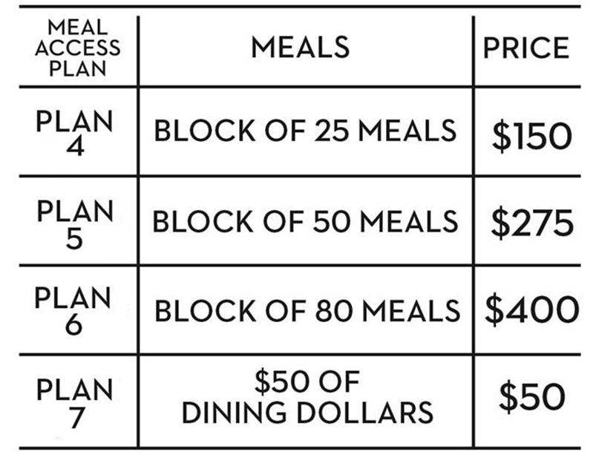
2019/2020 Meal Plans
All students under 21 years of age with less than 60 UCM accepted credit hours who have not lived on campus for 2 years must select from meal plan 1 - 3.
Junior and above and all students residing off campus may select from meal plan 1 – 7.
All Dining Dollars will be able to be used at on campus locations only, this does include SPIN! Pizza, Starbucks and Traditions. Purchase additional dining dollars and/or block meals below.

Slide 73
Contact Information for Dining by Sodexo
Website: ucmo.sodexomyway.com
Phone: 660-543-4012
Email: diningservice@ucmo.edu
Campus Catering by Sodexo:
Catering Manager: Stephanie Sweeney
Phone: 660-543-4440
Email: SodexoCatering.UCMO@sodexo.com
Ordering Website: https://ucmo.catertrax.com/
Student –On-The-Go order form: https://ucmo.sodexomyway.com/catering
Orders need to be placed three business days in advance at Ellis Dining Center or Westside Market in Todd Hall
Items may be picked up anytime the dining centers are open
Available to student organizations
All food provided in disposable containers. Does not include an set up or clean up, and if paper products (plates, napkins, etc) are needed they must be ordered.

Slide 74
Elliott Student Union (ESU)

Slide 75
ESU: What’s with all the mess?
Elliott Student Union Renovation
Construction began on a new auditorium that will seat close to 300 and an updated south entry to the Elliott Student Union (ESU) in October 2018. (See attached slides)
Despite a few surprises and many inclement weather days, the project is progressing. Completion is anticipated prior to the start of Spring 2020 semester.
The patience and cooperation of all Union tenants, faculty, staff and students has been appreciated during this process.
The Union Bowling Center will be updating furniture and service area which will also enhance the UCM welcome factor to the south entry. The ESU’s south entry receives over 300,000 visitors annually.

Slide 76
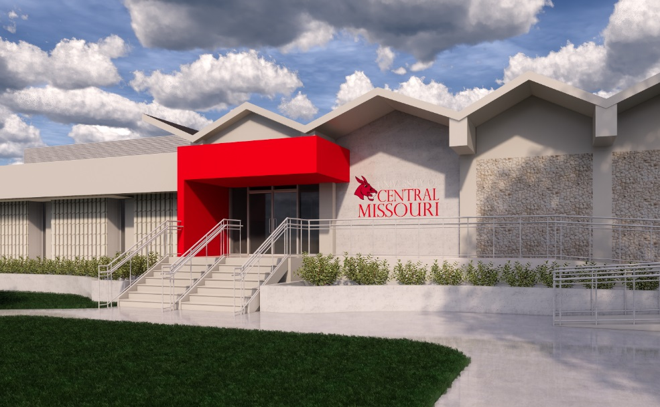
ESU:Coming soon
Concept art depicting the new South entry and the new auditorium

Slide 77
ESU: Other News
Mark your calendars
Taste of UCM August 29 3:30 – 5:00 pm
Union Birthday Bash September 25
UCM Holiday Market December 4, 4:00 – 7:00 pm
Union Cinema
New partnership program available to Student Organizations.
ESU will fund (3) movies per semester.
Applications currently being taken for Fall 2019/Spring 2020.
Secret Life of Pets 2 will be our first feature of the year!
FAC/STAFF Movie Night---Tuesdays 5:30; 8:00 pm. Free popcorn with
UCM ID! Families welcome.

Slide 78
Public Safety

Slide 79
Public Safety
Contacting or Reporting Crime to
From Campus phones dial 911 or 4123
From Cell phones dial
660-543-4123 or
911 (Goes to JOCO)
Text 660-422-2632
e-mail dispatcher@ucmo.edu
ucmo.edu/crime

Slide 80
Textcaster www.ucmo.edu/textcaster
Emergency Messages and Timely Warning Notices: Get alerts about imminent emergency situations affecting the Warrensburg Campus and warnings in response to reported crimes.
Severe Weather Alerts: Get alerts about tornado & thunderstorm warnings in the Warrensburg area.
Warrensburg Campus Closings / Delayed Openings: Get alerts when classes in Warrensburg are cancelled or delayed.
CAMPUS EYE APP
FOR YOUR ADDED SAFETY…...UCM utilizes technology as extra means of contacting Public Safety. Download it from our website.
Campus Eye puts a direct line to campus safety in every student's hand. It gives them ready access to an emergency line no matter where they are. Users can provide a picture of a crime in progress for you to use as proof in an investigation. A map with GPS location is also provided for responders’ convenience. The app can also be used to report less serious (but nonetheless aggravating) crimes, such as parking violations.

Slide 81
Access to areas on university property should be requested through Access Control. This includes Offices, Residences, Buildings, and Classrooms. Keys or fobs may be issued to university personnel with appropriate need and authorization. Contact Access Control at 660-543-4101 or Accesscontrol@ucmo.edu
Parking Services 306 Broad Street
University parking lots are provided for the use of students, faculty,
staff, and visitors. Parking permits are available for purchase online at
https://www.ucmo.edu/public-safety/parking-services/index.php.
Please direct any questions to Parking Services at 660-543-4098
or parking@ucmo.edu
Access Control 306 Broad Street

Slide 82
Student Activities

Slide 83
Student Activities 2019-2020 Dates
Week of Welcome: August 18-24,
details at https://www.ucmo.edu/osa/wow/
Family Weekend: September 27-29,
details at https://www.ucmo.edu/current-students/student-experience/family-weekend/
Homecoming: October 12,
details at https://www.ucmo.edu/current-students/student-experience/homecoming/
A Fall Student Activities Calendar of Events is available at:
https://www.ucmo.edu/current-students/student-experience/student-activities-calendar/

Slide 84
Student Behavior and Referrals

Slide 85
CARE Team Referrals
Students, faculty and staff members who wish to inform UCM’s CARE Team of a community member whose behavior potentially threatens the health and safety of that person or others, may contact the CARE team by using the Academic Alert form or by emailing the Associate Vice President for Student Services at bowman@ucmo.edu.
The CARE Team asks that emails provide the following information:
1. Name and 700# of the individual whose behavior raises a concern
2. Basis of the concern (a description of the behavior)
3. Name of the reporting party (optional)
In case of an EMERGENCY or imminent threat:
Call 911 or the Department of Public Safety at 660)543-4123

Slide 86
Online Reporting Forms
There are many ways to report a concern!
Each of these tools is interconnected and uses the same tracking system.
Mandatory Reporter Form Public Safety Form
https://cm.maxient.com/reportingform.php?UnivofCentralMissouri&layout_id=4
CARE Team Referral Form Request for Outreach / Assistance
https://cm.maxient.com/reportingform.php?UnivofCentralMissouri&layout_id=11
Public Feedback & Complaint Form
https://cm.maxient.com/reportingform.php?UnivofCentralMissouri&layout_id=12
If you are uncertain about reporting, please call Public Safety (660-543-4123)
or Student Experience & Engagement (660-543-4114).

Slide 87
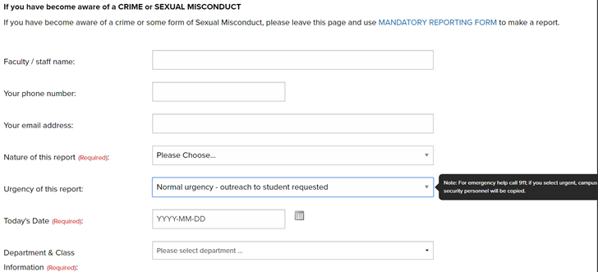
Submitting a report
Please read through the instructions at the top the first time submitting.
Complete the form.
Urgency of this report:
Normal Urgency- This reports the incident to appropriate personnel
Urgent- Potential Safety Concern- Public Safety will be notified. Please consider calling 911.

Slide 88
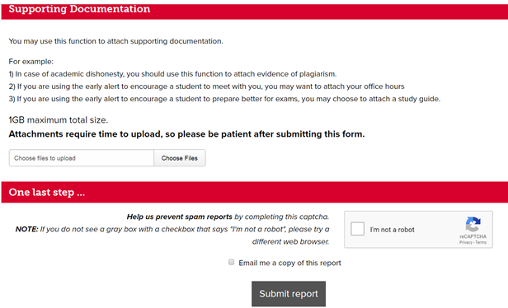
Submitting a report
Please select email me a copy of this report if you would like follow up on the report.

Slide 89
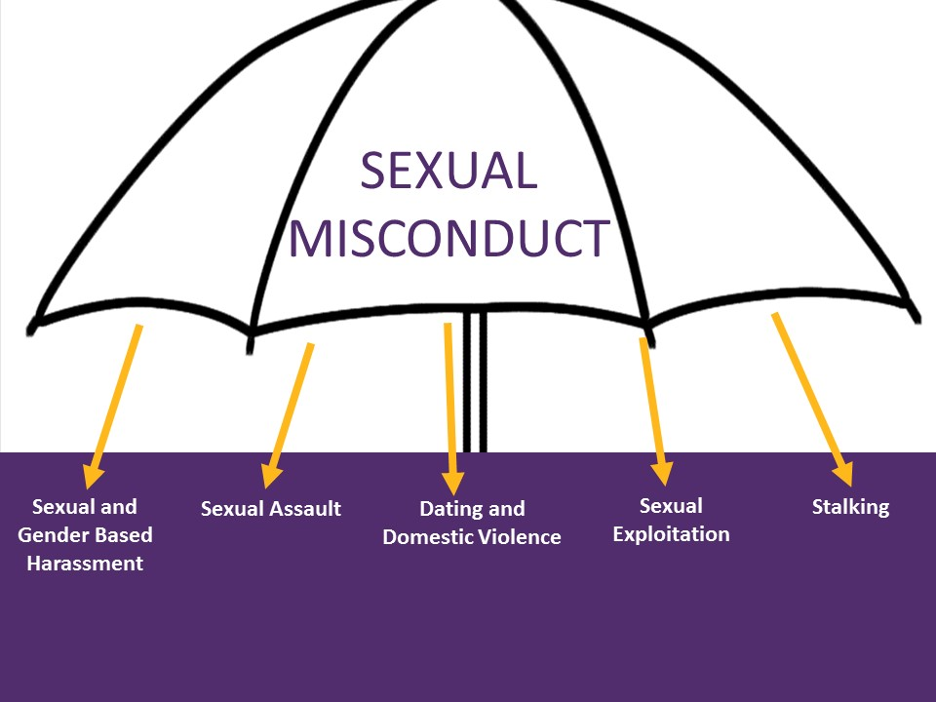
Sexual Misconduct
Non-consensual (unwelcome/unwanted) contact of a sexual nature that can be verbal, non-verbal or physical that creates a hostile environment.
You are a Responsible Employee with obligations under UCM policy
ALL UCM Employees are responsible employees, unless otherwise designated (Counseling Center and Health Center)
MUST report known incidents of sexual misconduct - Mandatory Reporting Form
Not allowed to remain anonymous
Must include complainant’s name
Can not promise confidentiality

Slide 90
University Store

Slide 91
All Inclusive Digital Content
Course materials exclusively as digital content
Generally has a homework component for student to complete assignments, quizzes, etc. online
Students enrolled in a course using All Inclusive will be billed for the content unless they "opt out" during Add/Drop period
All Inclusive is distributed initially via Blackboard with direction from instructor to content provider (VitalSource)
University Store will place charges on student accounts using Banner detail codes BTAI or BNAI
University Store website identifies courses using All Inclusive with prefix "AI" in the book title. Pricing info is provided on
website, but the book is not added to their shopping cart
Printed course material available, but not a substitute for digital content

Slide 92
All Inclusive Digital Content
Number of Disciplines: 15
Courses using All Inclusive: 41
Course sections: 138
Number of Unique Titles: 34
Students: 4024 (using 1 or more AI titles); Capacity: 4562
Publisher Partners: 4 (McGraw-Hill (20); Pearson (7); Cengage (6); WW Norton (1)

Slide 93
University Store-MIC
Open Monday-Thursday, 2 pm - 6 pm when classes are in session
Onsite textbook rental returns and buyback fall & spring semesters
Web orders for textbooks and merchandise available for pickup in MIC Learning Commons
Courier Service Available Monday through Thursday

Slide 94
University Store-The Crossing
Regular Store hours, fall semester: Mule Stop, M-R: 7:30am-7pm, F: 7:30am-6pm, Sa: 9am-3pm, Su: 12noon-5pm. Main Store: M-R: 9am-7pm, F: 9am-7pm, Sa: 9am-3pm, Su: 12noon-5pm
Course materials (textbooks), supplies and technology accessories are located with general with emblematic merchandise at University Store-The Crossing.
Business offices remain on the lower level of Elliott Student Union
Textbook buyback & rental returns are now conducted at University Store-The Crossing instead of SRWC.

Slide 95
Online Order Pickup-Warrensburg Campus
Students living in traditional residence halls who chose campus pickup with get their orders 4 locations in University Housing
Ellis Complex residents pickup orders in Ellis TV Lounge
UCC & Foster Knox residents pickup orders in Kansas City & St. Louis Rooms in UCC
Fraternity Complex/Panhellenic/South Yeater/Fitzgerald residents pickup orders at Panhellenic Hall, ground floor
Nattinger-Bradshaw/Houts-Hosey/Nickerson/Todd/South Todd residents pickup orders in Houts-Hosey WCRL
All other housing residents and office campus students will pickup orders in University Store-The Crossing, lower level

Slide 96
Online Order- University Housing
Distribution times
Thursday, August 9 12:30pm - 3:30pm
Friday, August 10 3:00pm - 6:00pm
Sunday, August 12 12:00pm - 3:00pm
Monday, August 13 3:00pm - 6:00pm
Tuesday, August 14 3:00pm - 6:00pm
Web order distribution from University Store aligns with our regular business hours. Daily hours are posted on our website, ucmbookstore.com.

Slide 97
OAS – Office of Accessibility Services

Slide 98
The Office of Accessibility Services is dedicated to providing persons with disabilities equal access to the functions and facilities of the University of Central Missouri. We are committed to providing students with disabilities services and accommodations to achieve equal opportunity to education and other student activities.
Contact information:
Danelle Cord
Associate General Counsel / Director of Accessibility Services
Cathy Seeley
Coordinator of Accessibility Services
Elliott Union 224
access@ucmo.edu
660-543-4421

Slide 99
JCKL Library

Slide 100
JCKL UPDATES
Updated JCKL “logo”
Building Refresh:
Painted 1st floor building hallways
Updating in-building signage
In process of replacing 20-year old soft furniture for student, faculty, library patron use
Converted former conference room to group study room (JCKL 2461)

Slide 101
JCKL UPDATES: PRIMO: New integrated library system

Slide 102
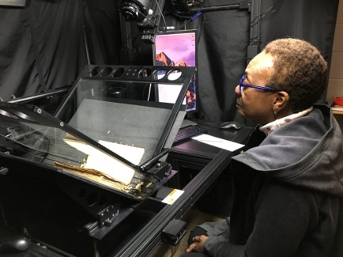
JCKL Updates: Collaborative Digitization Project
Received Library Services & Technology Act (LSTA) grant to digitize selected collections
Community partners:
Trails Regional Library System
Johnson County Historical Society
The Daily Star Journal
University partners: School of Communication, History, and Interdisciplinary Studies; School of Visual and Performing Arts; and the Gallery of Art and Design

Slide 103
JCKL Updates:
Library Door & Gate Counts FY19

Slide 104
JCKL UPDATES:
Study Room Usage FY19

Slide 105
JCKL UPDATES: Circulation of Physical Materials Circulation of physical material is -17% from FY18 and down 60% compared to FY16

Slide 106
JCKL UPDATES: Circulation of Physical Materials by Patron Category Physical circulation fell in all categories from FY18; -17% for undergrads, -6% for grad students, -27% for staff & -26% for faculty

Slide 107
CTL – Center for Teaching and Learning

Slide 108
CTL UPDATES
Debbie Gerhart, Coordinator, Technical Training, retired
Dr. Athena Anderson joined CTL as an Instructional Design Specialist
Developed centralized office space with dedicated training facility for faculty development
Organized new faculty orientation programming
Professional development sessions provided for faculty throughout year:
Best practices, Using Blackboard effectively, course design
In-person and 3rd party webinar broadcast events
Trainings converted to online format for ease of access
Blackboard support and administration

Slide 109
CTL UPDATES (continued)
CTL hosted specialized training for select groups of teaching employees (e.g., academic advisors)
Department Chairs’ Development Bootcamp and Monthly Development Series
Collaborated with Extended Studies to offer ACUE Certification for Faculty
Collaborating with Student Success to develop Title III First Year Experience

Slide 110
CTL UPDATES (continued)
NEW: Best Practices in Teaching & Learning:
CTL Faculty Fellows program held in June 2019
Participating faculty certified to teach online
Designed & offering options for faculty to obtain certification to teach online
With colleges, designed and offering online course review process
Launching faculty mentoring program

Slide 111
CTL UPDATES (continued)
CTL offers three grants to full time faculty:
Speakers Series grant
Institutional Improvement Grant, and
new Academic Advancement Instructional Development grant.
In FY19, CTL funded over $60,000.00 for:
30 Speakers
40 Academic Advancement grants
15 Institutional Improvement grants

Slide 112
CTL UPDATES (continued)
Learning Space Instructional Design Team (LSIDT)
As of June 30, 2019: 66 rooms have been or are being reviewed by the LSIDT
(There are 300+ classrooms on campus.)
The LSIDT continues to:
improve its understanding of learning space and active learning design using research-based practices
revise and improve the review process.
Collaboration between the LSIDT, OT, Procurement, and FPO is helping streamline the classroom design and upgrading process.

Slide 113
CTL UPDATES (continued)
Active Learning Engagement Classroom (JCKL ALEC 1268)
For 2018-2019: 12 classes were taught in the ALEC room (JCKL 1268)
A fourth monitor was added to JCKL ALEC 1268, completing the rooms original design
19 ad-hoc sessions were held for training and organizations / groups
JCKL ALEC 1268 was the focus of a research project and a national conference presentation:
A research project by four UCM / MU doctoral students, "A Qualitative Analysis of Active Learning Engagement Classroom Perceptions."
A poster session entitled "Perception of Teachers and Students Using an Active Learning Classroom" at the National 2019 Teaching Professor Conference by Chalice and Mike Jeffries

Slide 114
CTL UPDATES (continued)
CTL team members earned a number of certifications over last year:
Project management for instructional design
Course design for Accessibility and UDL
Master Reviewer certification (QM)
Online Course Design Certification (OLC)
Online Teaching Certification (OLC)
Designing a Flipped Classroom Certificate (OLC)

